Slide 1

New energy
Healthy development of green environmental protection

Slide 2

Contents
01
Solar Power
02
Wind Power
03
Nuclear power

Slide 3
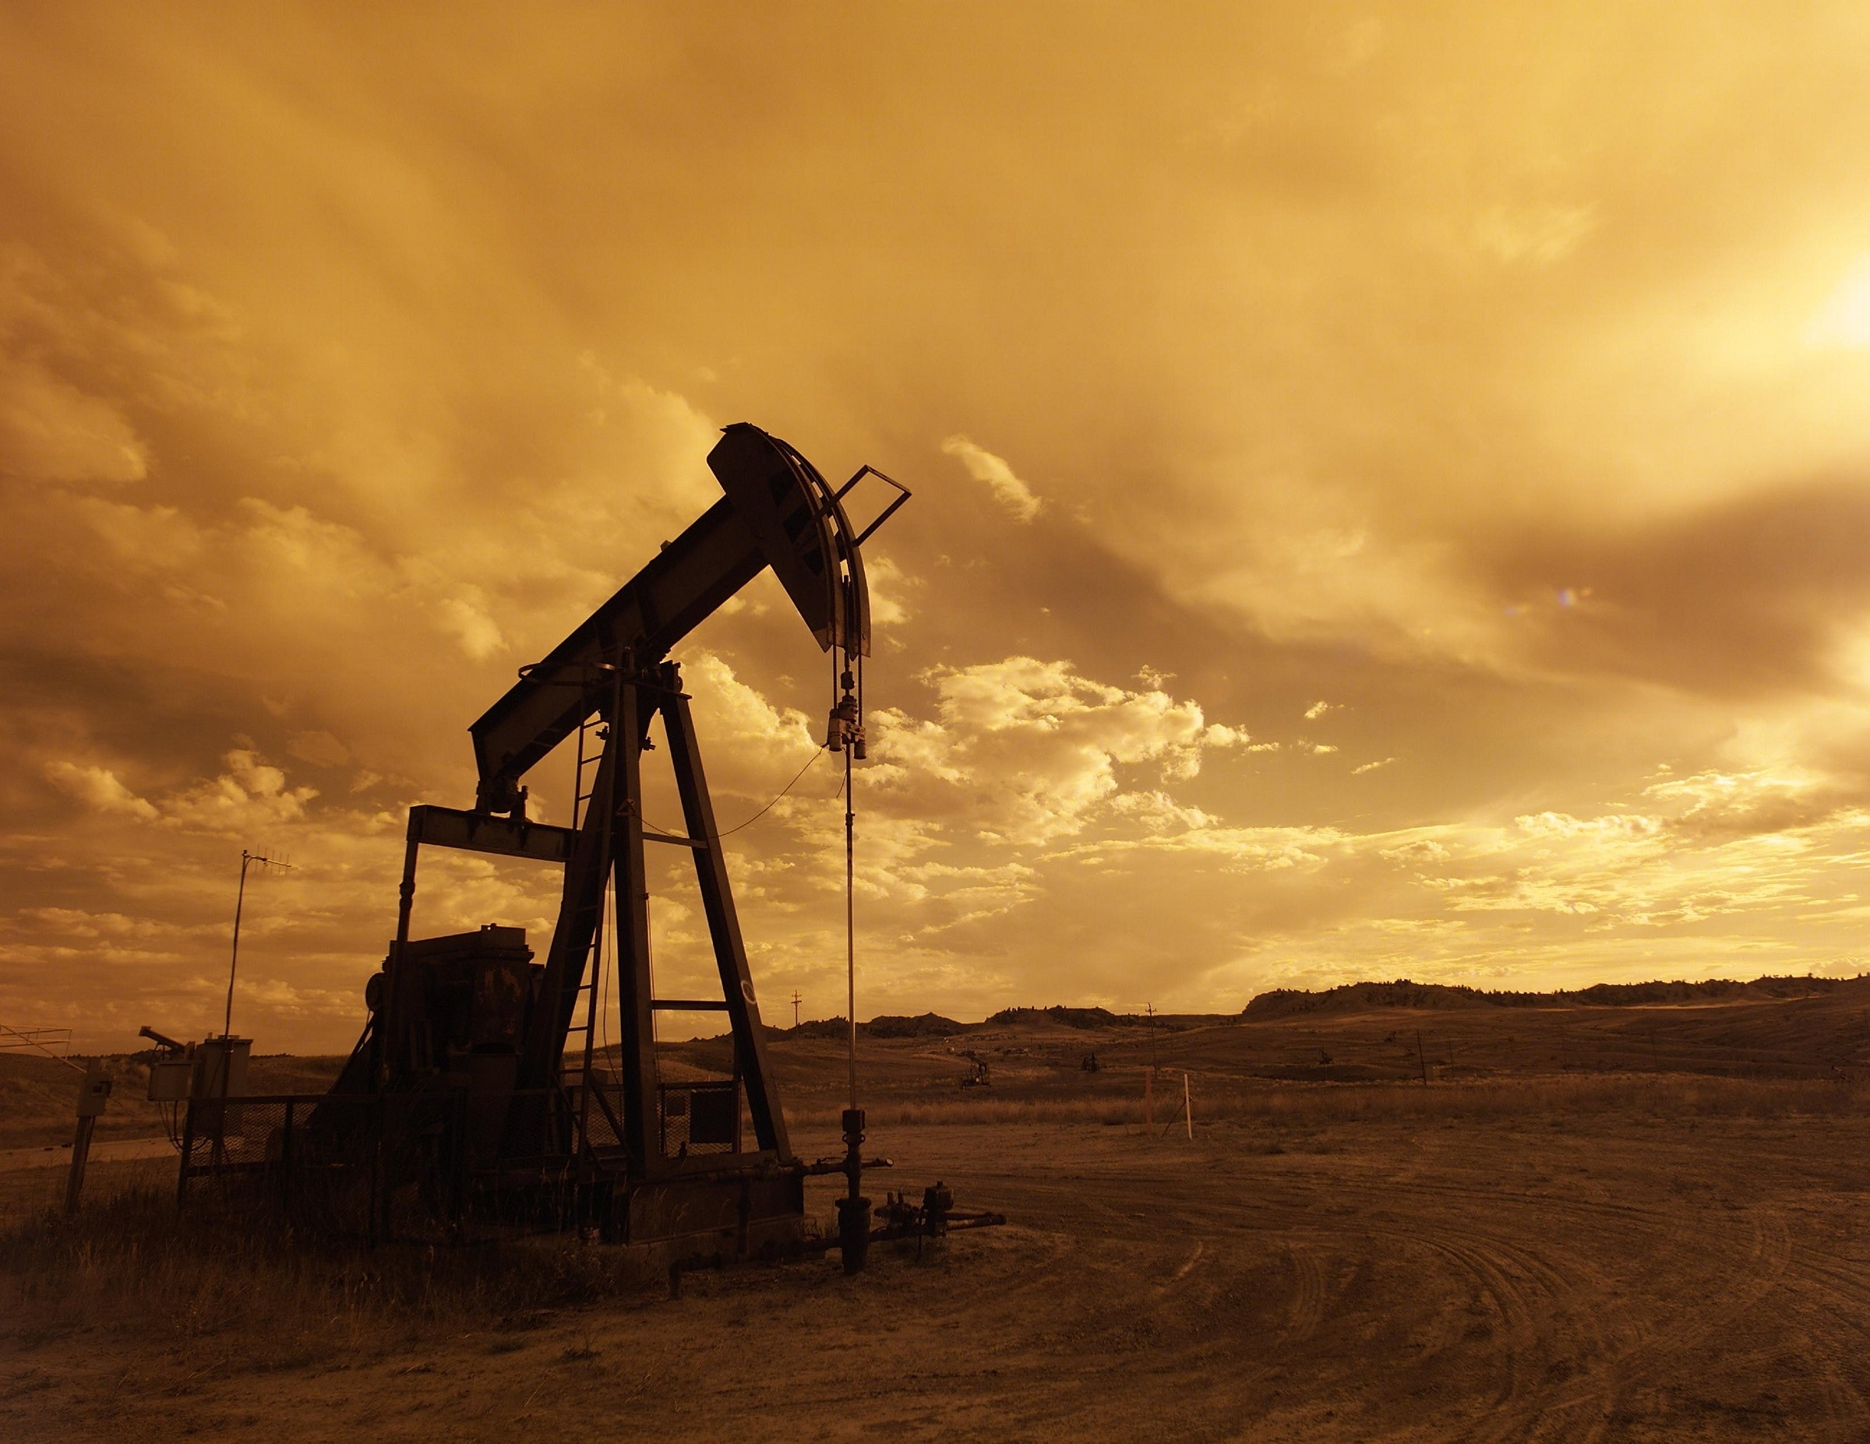

Fossil Fuels
The supply of fossil fuels is finite, we need to find alternative new energy sources!

Slide 4
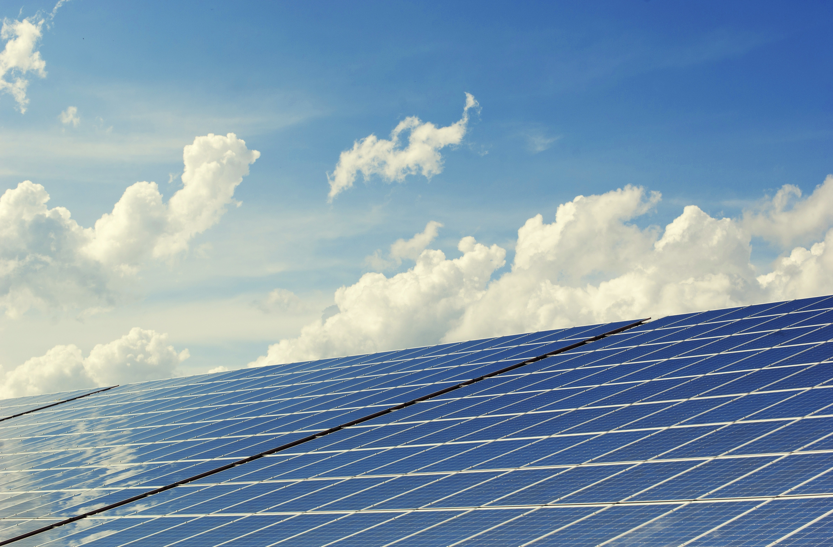
1
solar power

Slide 5
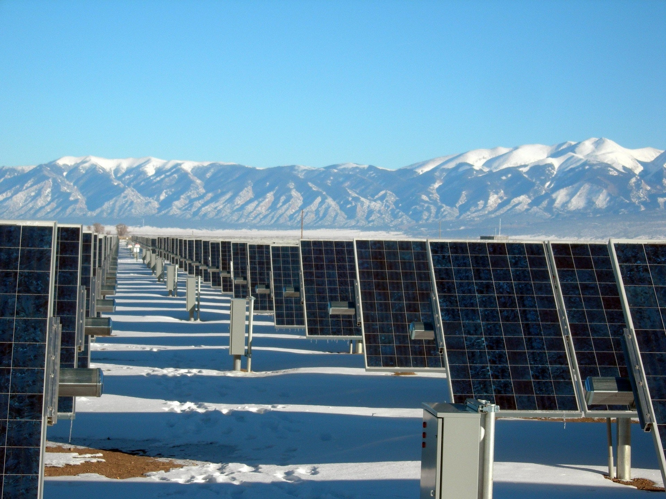
点击添加相关标题文字
Tamil Nadu solar power station
Solar panels catch energy directly from the sun and convert it into electricity
1
One of the world's largest solar power stations
2
More than 2.5 million solar panels
3
Generate enough power for 750,000 people

Slide 6
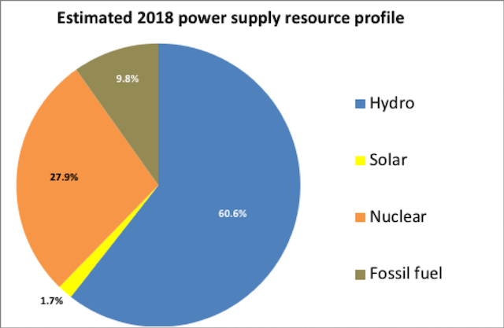
点击添加相关标题文字
Solar power percentage
Solar powers provides less than 2 percent of the world’s energy
1
The cost of the panels is still very high
2
Clouds and darkness also cause solar panels to produce less energy

Slide 7
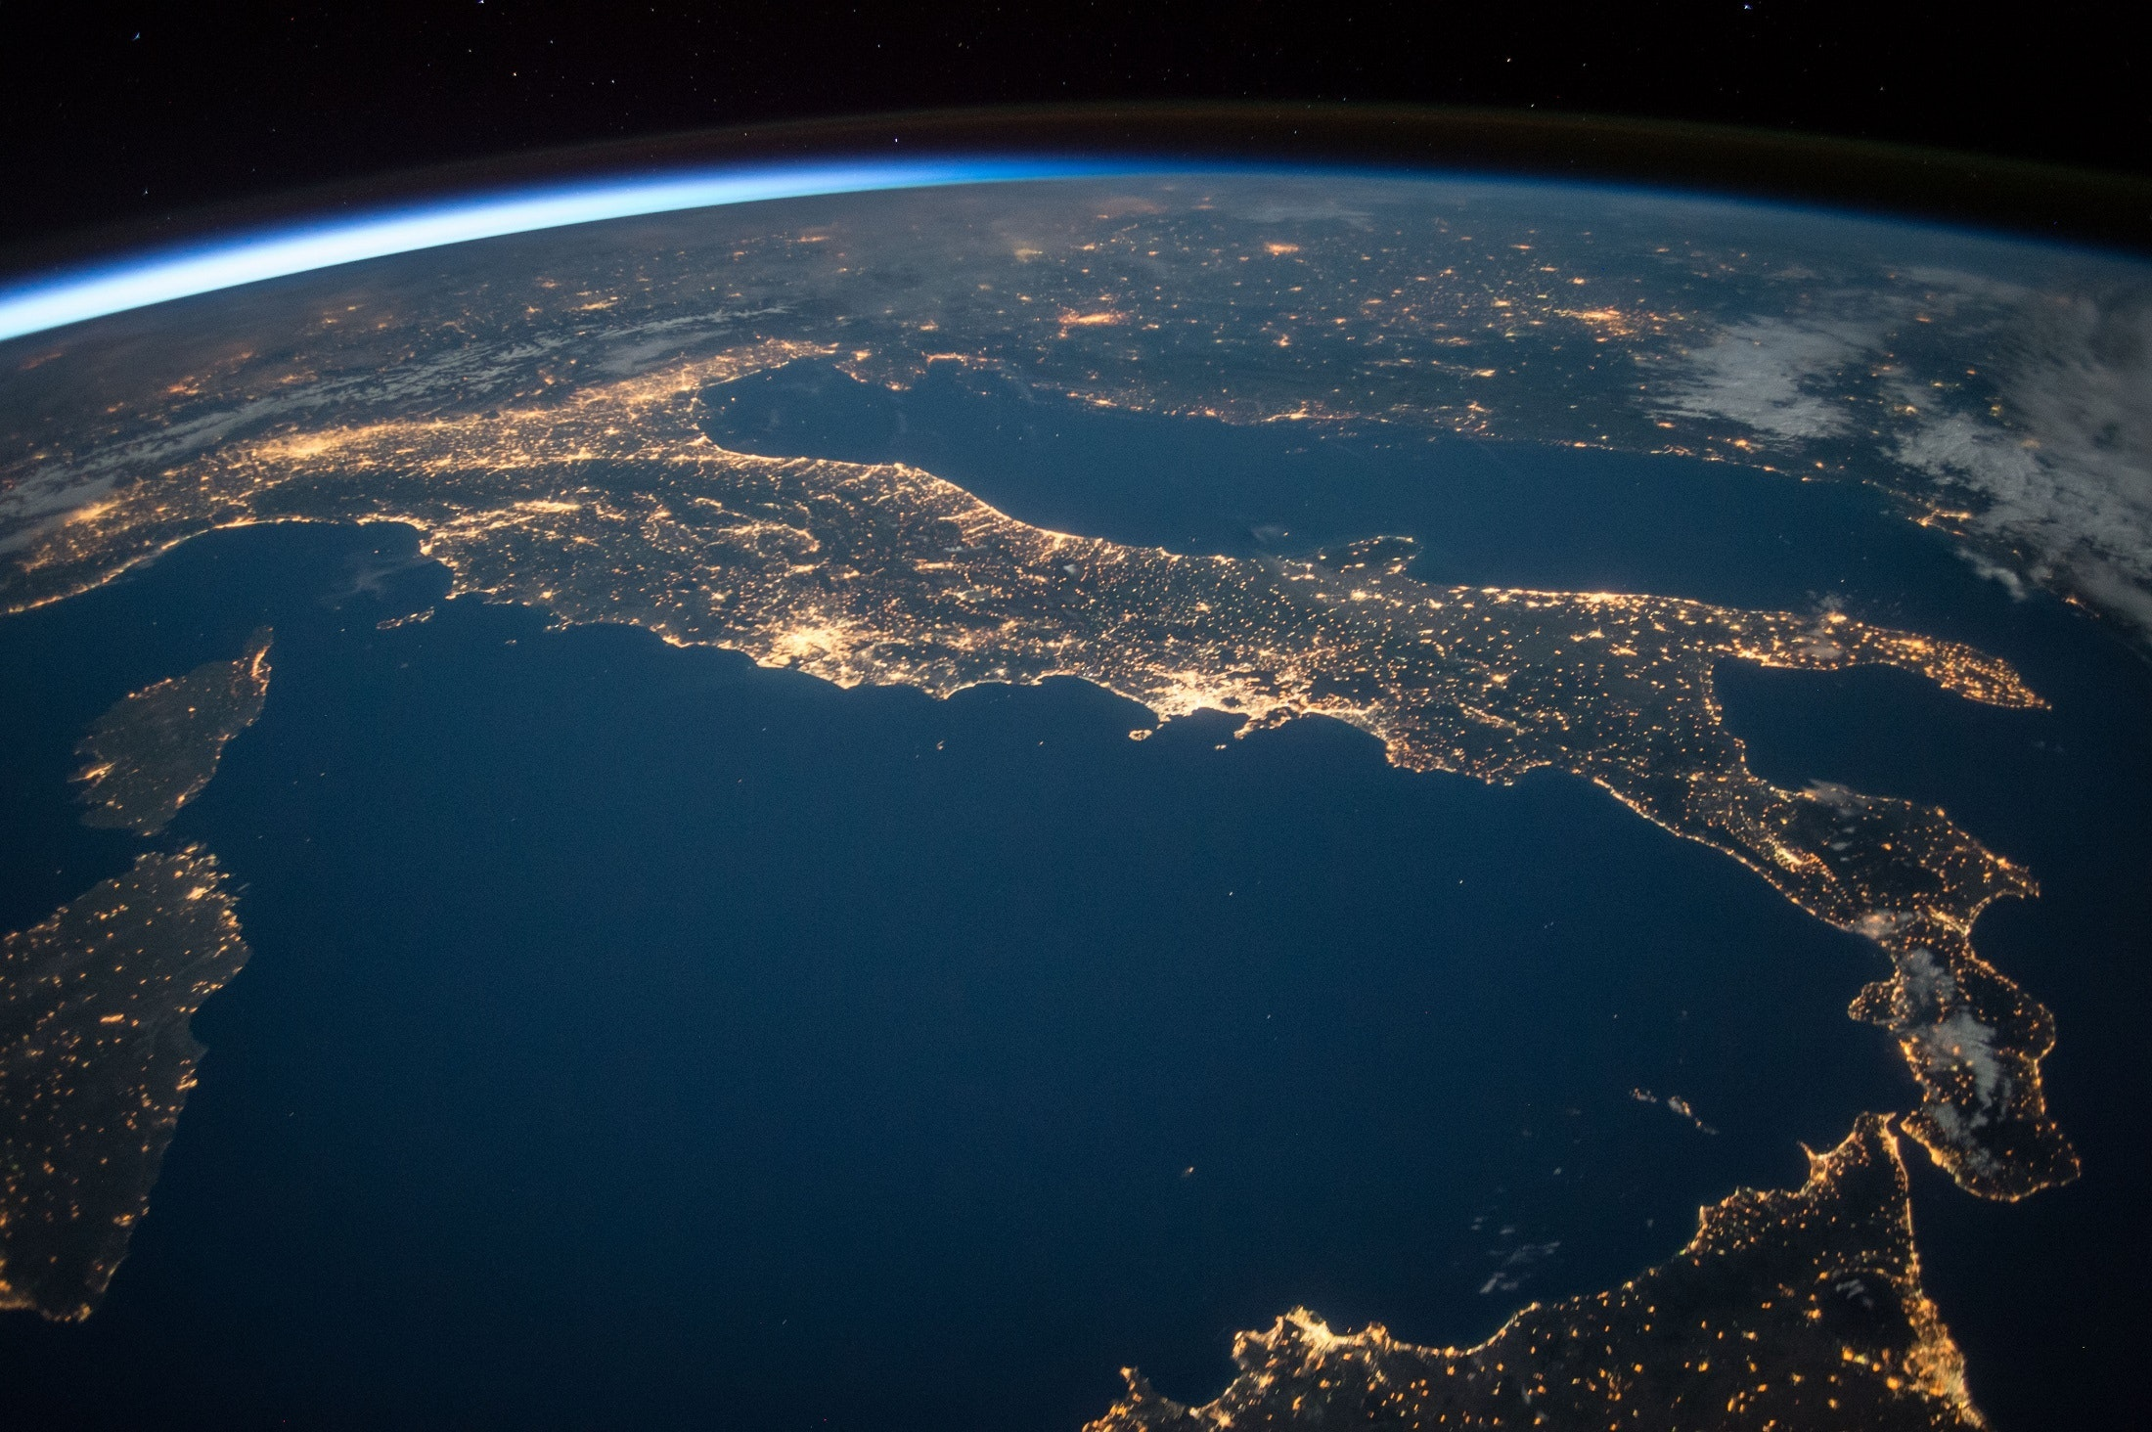
Space is the ideal place to gather energy from the sun
No clouds and no nighttime.
Send the power back to Earth.
Initially require a lot of money,but eventually it could provide continuous,clean energy that would be cheaper than other fuels.

Slide 8
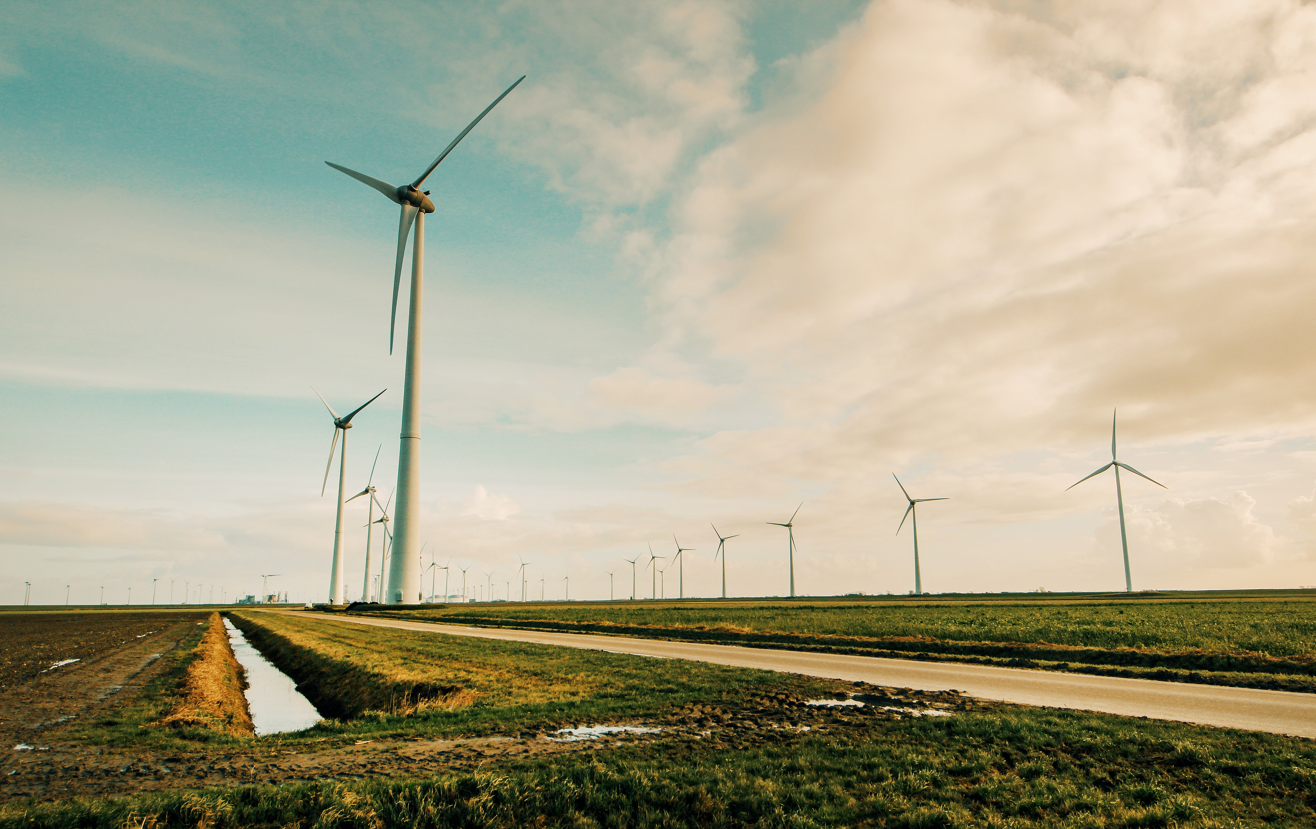
2
Wind power

Slide 9
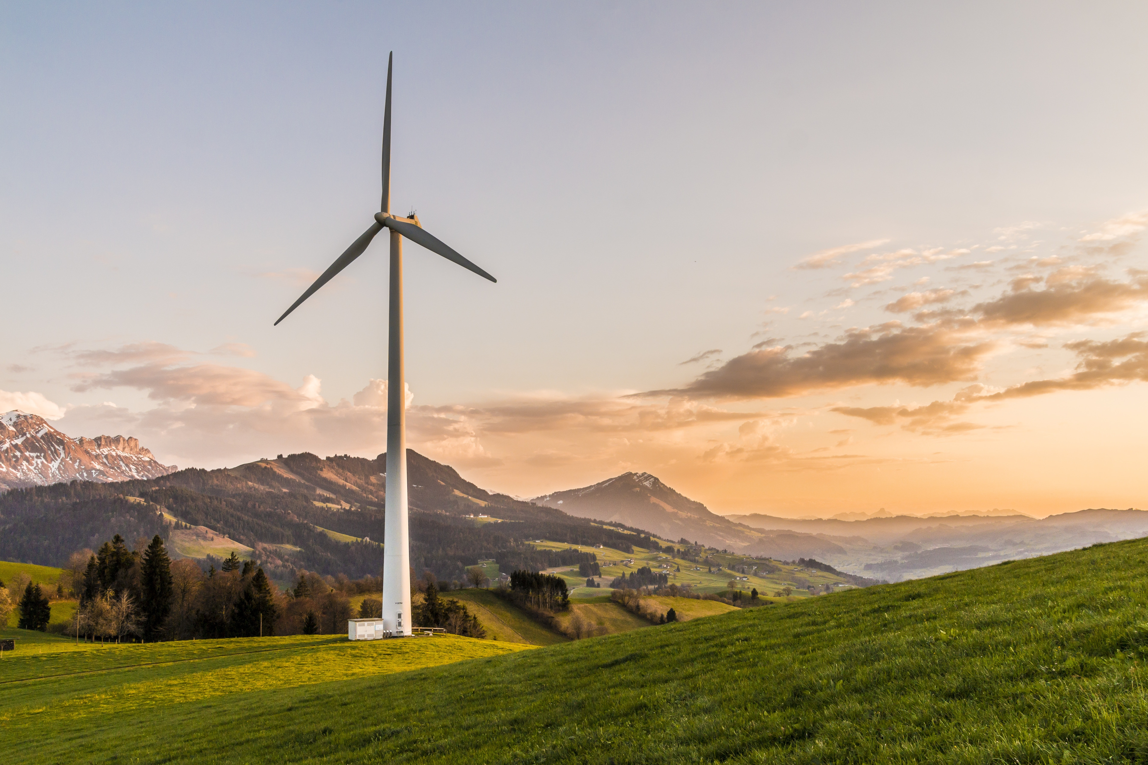
点击添加相关标题文字
Wind:the fastest-growing new energy source
Another way of collecting energy from the sun
1
Caused by the sun’s heat rather than its light
2
Wind power works well even on cloudy days

Slide 10
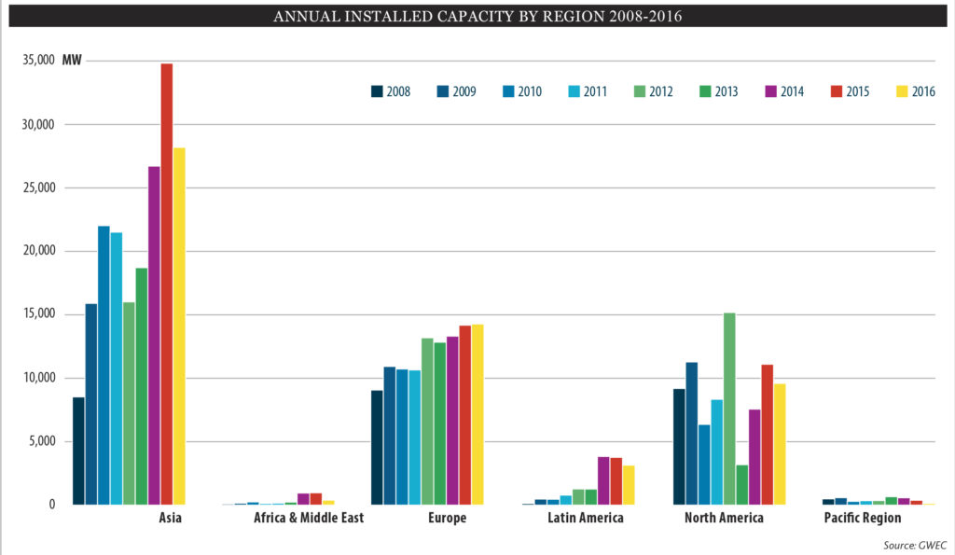
All over the world,incentives designed to decrease the dependence on oil and coal have led to a steep increase in wind-powered energy.
1
Asia:23,000 megawatts
2
Europe:15,000 megawatts
3
North America:10,500 megawatts

Slide 11

Wind:blow or not?
doesn't blow:no adequate energy
strong wind:create too much power

Slide 12
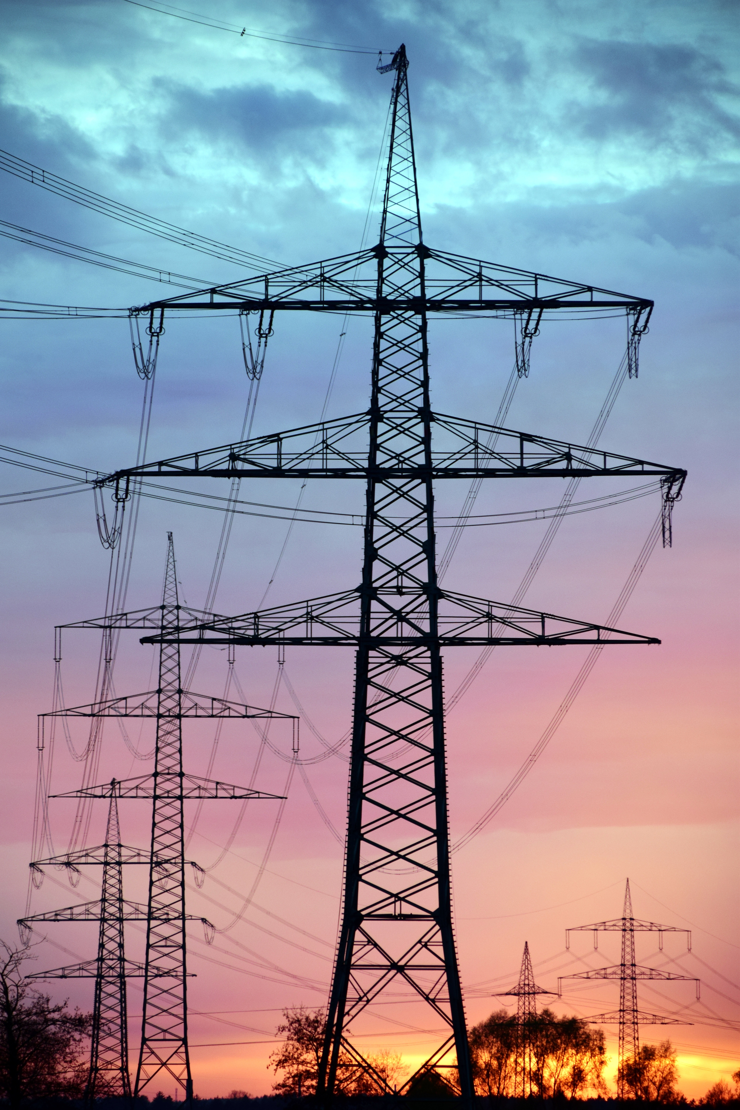
What’s needed for both wind and solar is a way to store a large energy surplus.However,most systems are still decades away from making this a reality.

Slide 13
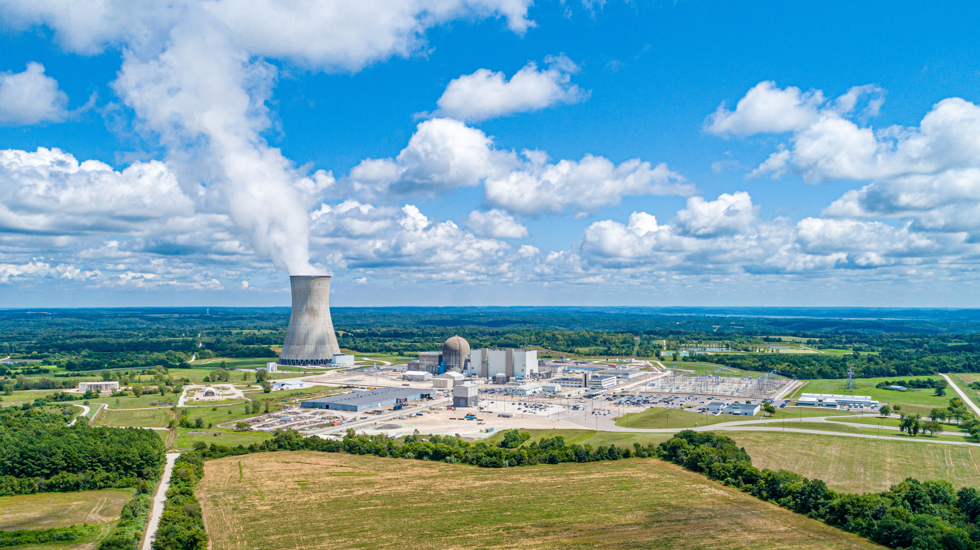
3
Nuclear power

Slide 14
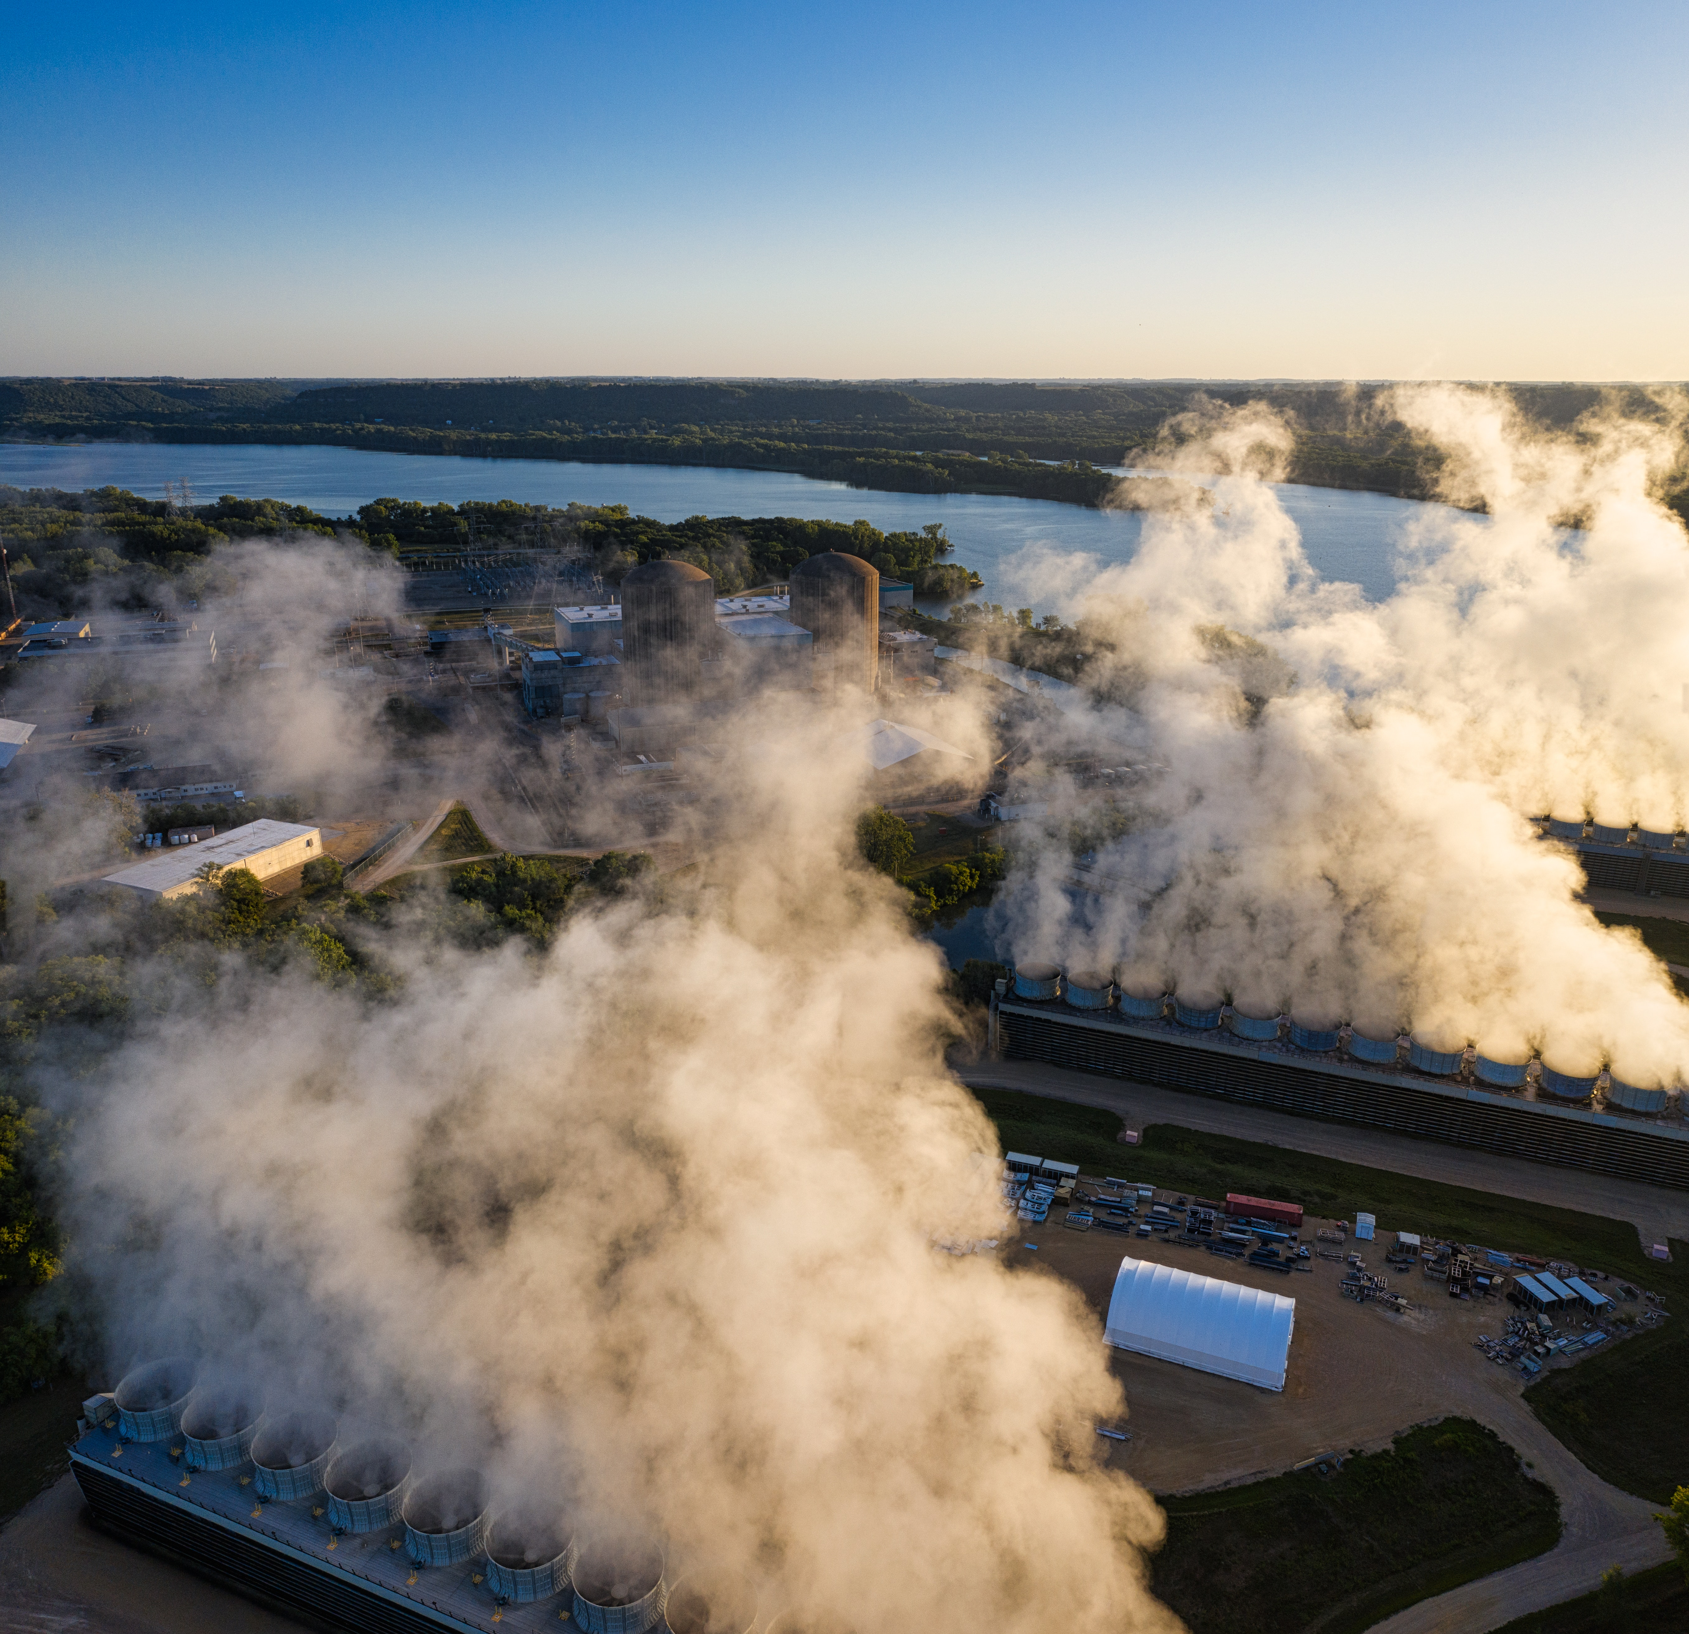
点击添加相关标题文字
1
1970s:nuclear power was seen as the main energy alternative
2
1980s and ‘90s:use of nuclear power declined due to 1.accidents
2.concerns about nuclear waste storage and disposal
3.high construction costs

Slide 15
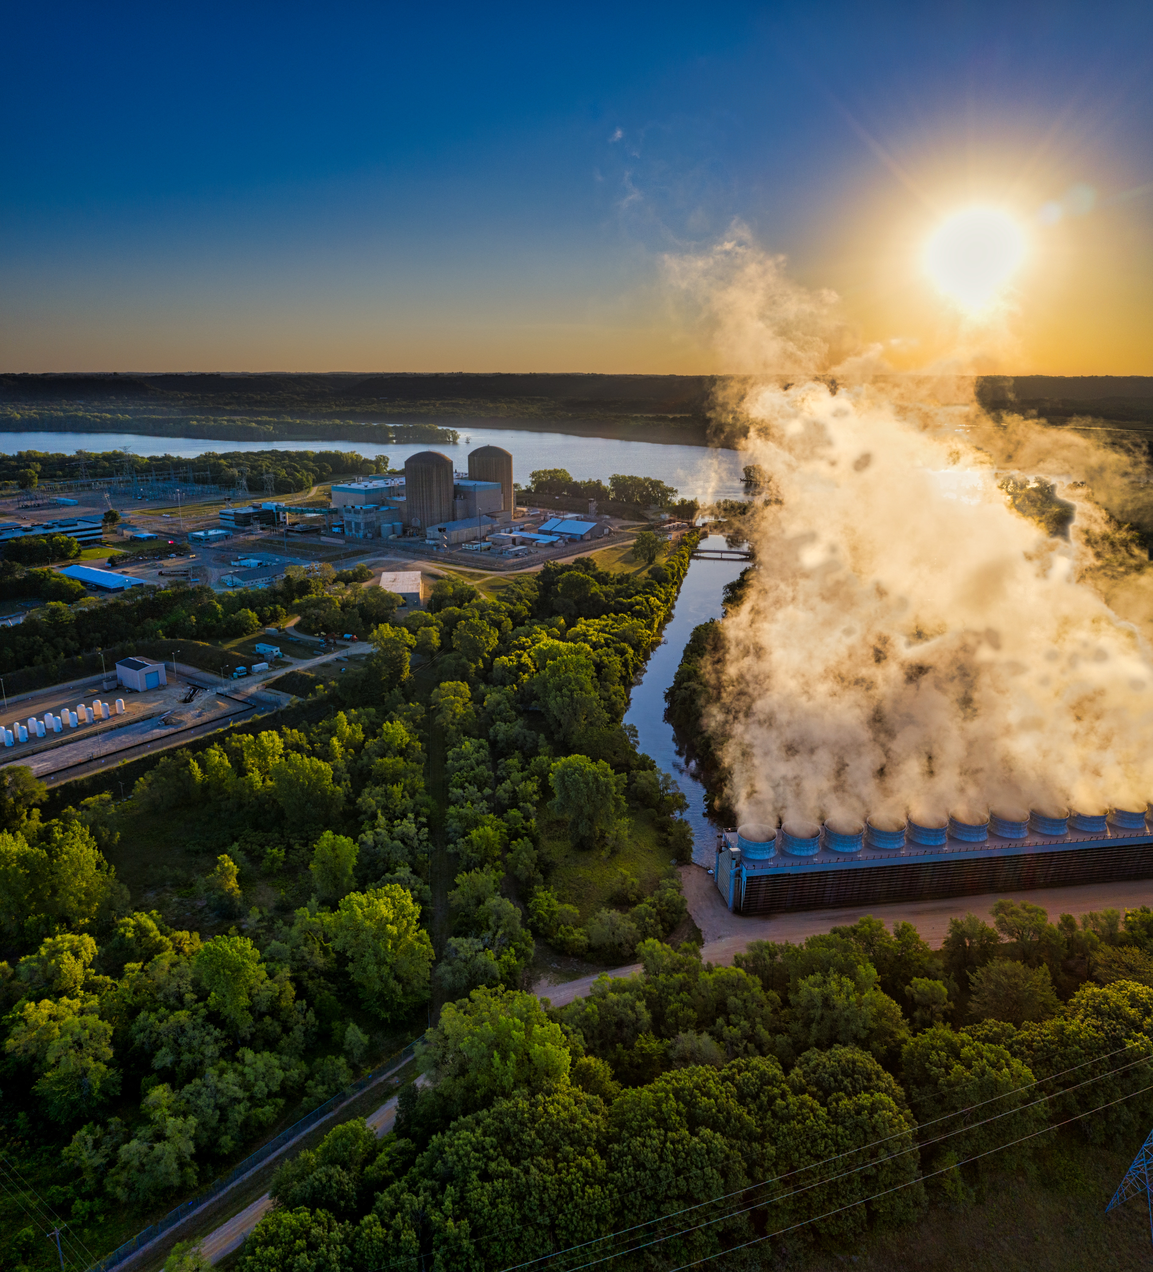
Today,times are changing：
Worldwide,about 450 plants generate 11 percent of the planet’s electric power
France,gets three-quarters of its electricity from nuclear power
China has started to build one or two new plants a year
India has also begun to utilize nuclear energy on a large scale.

Slide 16
Are any of these sources alone answer to our current energy problems?
No,but used in some combination.

Slide 17

Thank you for your listening!

